Slide 1



B
S
ATTLE
TREAMING
O
G
F
IANTS
SIMRAN (W952857)
PREETHI (W9566704) YUETONG (A0547990)
SAIKUMAR (W9534437)
JITHENDRA (W9563196)

Slide 2



This Project is to compare different factors of Netflix and Amazon Prime which a user should compare before buying a subscription.
P
Our target audience is the people who are confused about which streaming platform they should choose. Or is anyone interested in knowing an in-depth analysis of the content provided by Netflix and Amazon Prime?
In our project we want the user to understand the quality and quantity of a particular type of content provided on amazon prime and Netflix, and later decide which subscription he wants based on other factors as well.
roject
B
reif
Comparing the number of subscribers in amazon and Netflix amongst different countries.
Comparing both the platform’s content on the basis of movies and TV shows (classifying on genre and Age rating)
Use of different languages on both platforms over the year.
Comparing the average IMDB rating of those platforms.

Slide 3

D
ataset
D
escription
The data consists of the movies and TV shows available on Netflix and Amazon Prime Platforms. Along with the titles of Movies and TV shows, there is qualitative information like Age Rating, Language and Genre. Quantitative Information like IMDB rating and the number of subscribers rating.
The Years in which those shows were released are the time series data.
Overall data Included a Complete description of the shows which was needed to analyse the quality and quantity of Shows on that platform and to be able to distinguish them.
DATASET PREPROCESSING:-
Several online, excel and Power BI tools were used in order to understand the data.
A few columns were removed in order to reduce the data.
Different sorts of Calculations were done to add a new column in order to compare both platforms.
The genre Column was split (comma as a delimiter) and unpivoted to get the accurate result of a specific type of genre by using Power BI.
For the Language of the show, there were so many nominal categories and hence they were segregated into three major categories with the help of the excel tool.

Slide 4

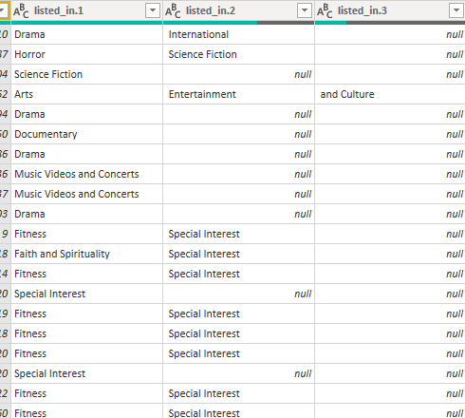
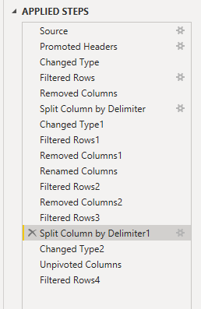
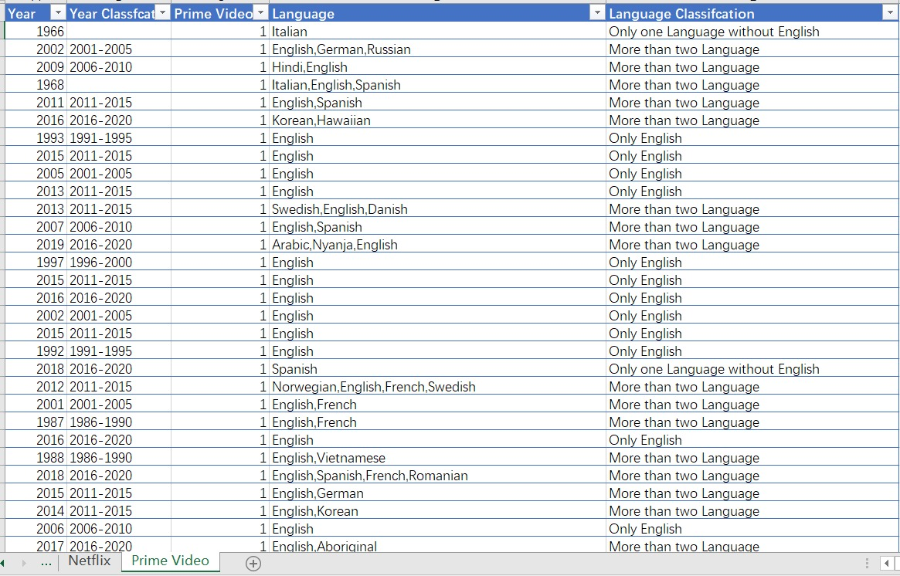
D
C
ata
leaning

Slide 6



V
J
isual
ustification
Simran’s
Preethi’s
Yuetong’s
I have used a bar chart to compare the percentages among different categories which makes it easier to analyze the information
Wanted to show the hierarchy of data which is easy to read & understand
The selecting bar graphs were chosen because it provides a better comparison and a clear picture of the differences between the three languages.
A bar Graph is chosen because it’s easy to compare 2 categories.

Slide 7

R
F
D
eflection
rom
ata
Netflix has a Majority of Movies in the 18+ age rating with the genre of comedy and documentaries. However, Amazon prime has its movies almost equally distributed amongst different age Ratings and genres (Highest being drama).
Amazon has lots of movies with other genres which makes it more versatile to offer a huge variety of content. Also prime has more than 3 times the number of movies as Netflix.
When it comes to TV shows Netflix (Mostly International Shows )has more TV shows than amazon prime (the majority being drama).
Netflix has a Majority of Content on Matured Audience whereas Most TV shows on amazon prime have Restricted age ratings.
With Passing Years the content in English and Regional language has increased on Netflix Although the increment of English language in amazon prime is not significant.
Netflix has the highest number of subscribers in the USA and India which makes sense because they [1] are multi-lingual language. Japan has the third highest subscribers because most of the people [3] in that country prefer Japanese over English (which Netflix provides).
Amazon is more versatile in terms of Age rating and genre. Whereas Netflix is more Versatile in terms of content.

Slide 8

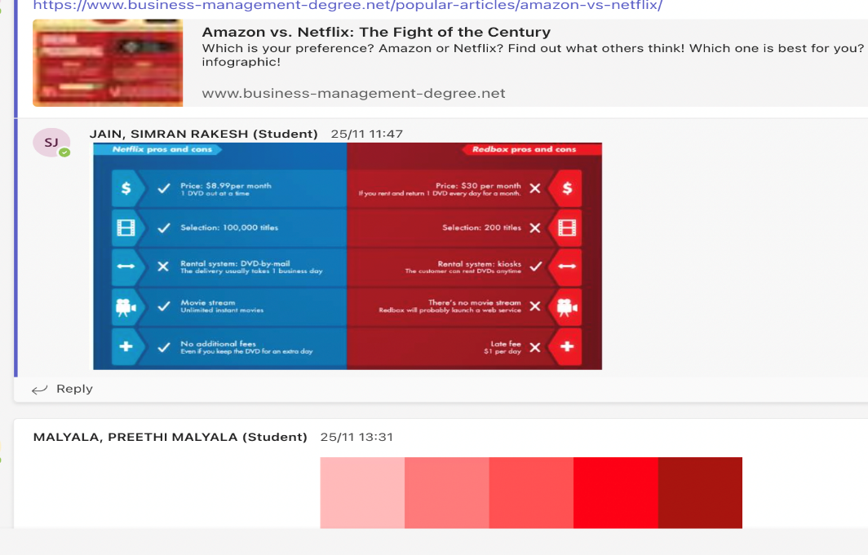
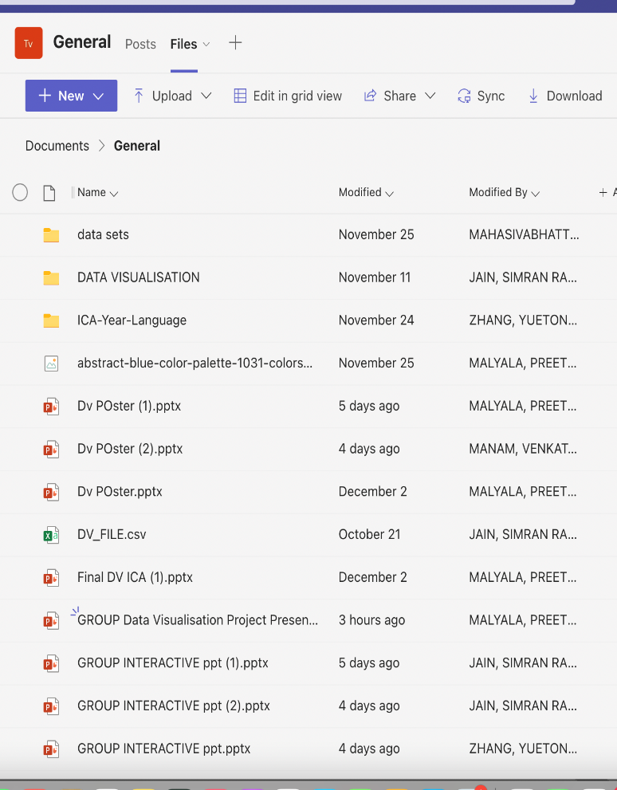


E
O
W
P
vidence
f
ork
lanner

Slide 9

T
C
eam
ontribution
TEAM MEMBERS | Source Data Collection | Develop Business Questions | Data Pre Processing | Develop Charts | Design Infographics | Consolidate Infograph | Prepare Presentation Slides
PREETHI MALYALA
SIMRAN JAIN
ZHANG, YUETONG
SAIKUMAR
JITHENDRA

